Slide 1
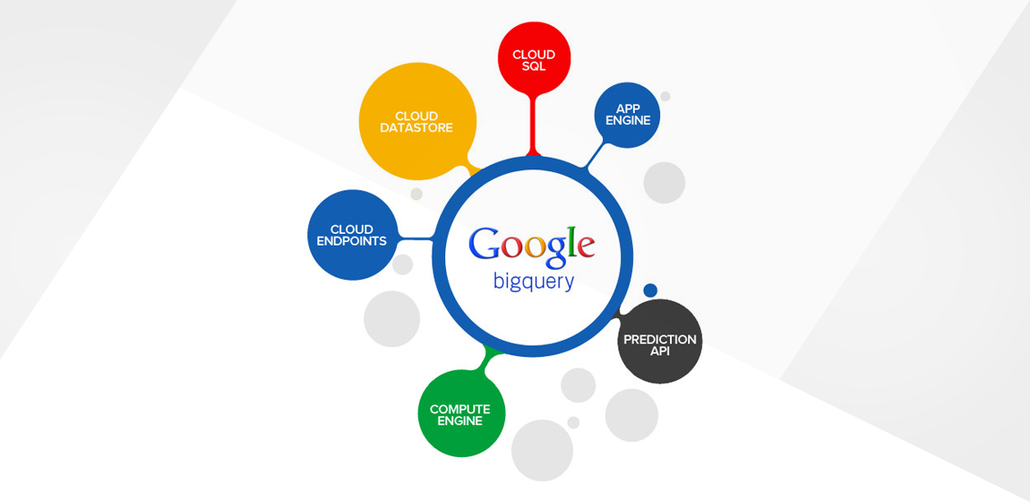
GOOGLE CLOUD SQL

Slide 2
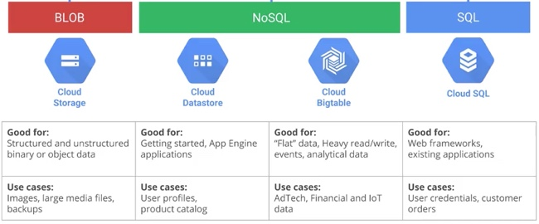
Cloud database

Slide 3
What is google cloud sql
Google Cloud offers a powerful database in the form of Cloud SQL, which provides your app the reliable and redundant storage it requires, along with sufficient space and speed of operation.

Slide 4
What is google cloud sql
A Cloud SQL instance is quite similar to a server. Several databases can be part of one Cloud SQL instance. It is a MySQL database which resides in Google Cloud. The database has all the functionality and capabilities of MySQL, with a number of additional features and a few unsupported features as well. Google Cloud SQL is ideal for small to midsize apps, doesn’t require any maintenance or software installation and is not difficult to use.

Slide 5
What Features and Restrictions Does Cloud SQL have?
As Google Cloud SQL is fully managed by Google, you don’t have to be concerned about database management, patch management or replication as Google takes care of it.
Since it uses open source databases that are among the most popular ones worldwide, i.e., MySQL databases, you can develop and deploy quickly. Instances are obtainable up to 500GB storage and 16GB RAM.
You can access and manage instances through a command-line interface or a web console without difficulty. So, Cloud SQL provides you with a fair degree of control.

Slide 6
What Features and Restrictions Does Cloud SQL have?
The pay-per-use option is quite inexpensive. By paying only for the time for which you access data, you save money, especially if you are operating a database used sporadically or lightly. For instances loaded more heavily, you can control costs through the package option.
Failover among the many physical locations where data is replicated is automatic. So, even if there is a major failure, your data is secure and your database is available. Google manages your backups and ensures that it’s not difficult to restore data when required, even if it implies point-in-time delivery.

Slide 7
Few additional features
Point-in-time recovery and automated backups
Hosting your MySQL databases in the cloud
Connecting with the secure sockets layer (SSL) protocol
Greater durability and availability of data which is replicated in various geographic locations
Support for MySQL connectors and wire protocol
Availability of instances in Asia, EU and the US
Asynchronous or synchronous replication among various physical locations

Slide 8
Restrictions
Google Cloud SQL doesn’t support user defined functions
It doesn’t support a few MySQL statements
It doesn’t support the SUPER privilege
It doesn’t support the SHA2 () function from MySQL

Slide 9
How do you manage your cloud instances
Creating an instance – While creating a Google Cloud SQL instance, the name of the instance is the only configuration setting needed. You can modify or accept the default values for all other settings for the instance.
Editing an instance – You can edit an instance and change its settings at any time after you have created it. The change is applied immediately for all instance settings except for size of the instance. To make changes in the size of an instance, Google Cloud SQL starts and stops the instance automatically for a short period of time. You can’t connect any apps to the instance during that time period. For apps built to handle temporary disruptions to database connectivity, this is generally not a problem.

Slide 10
Restarting an instance – An instance is stopped as all connections from it are drained. Google Cloud SQL restarts the instance when there is a fresh connection request for the instance, until which the instance stays shut. The requirement to restart any instance arises rarely, however.
Deleting an instance – When deleted, the data in an instance is lost permanently and it is a good practice to delete an instance following a scheduled backup or export of the instance.

Slide 11
How do you use your Cloud SQL instances?
Install a MySQL client – Install MySQL, request an IP address and authorize your network. Once you have done that, you can connect to an instance.
Connect using a MySQL client – Use the mysql command to start the interactive shell and identify the IP address of the instance and a user; enter SQL commands at the MySQL prompt; use the \s command at the MySQL prompt to make sure that you have a secure connection over SSL.

Slide 12
Use other MySQL client programs – Once you install the MySQL client, there are many client programs that you can use besides the mysql program. Regardless of the MySQL client you use, you send the IP for a Cloud SQL instance, a password and a user name, just like you would for mysql.
Use common SQL commands – to add users, check status variables such as checking uptime for instances and show the number of threads and connections. You can run some basic SQL commands using any reporting and admin tool that is compatible with MySQL or the MySQL client.

Slide 13
Google Cloud SQL makes it easier for you to manage your databases as it supports SQL-like queries, even as it doesn’t support all SQL commands. It offers a pay-per-use service for accessing your data stored on the inexpensive Google Cloud platform.

